Slide 1
Machine Learning
Chapter 04
Artificial Neural Networks

Slide 2
Artificial Neural Networks
Introduction
Artificial neural networks (ANNs) provide a general, practical method for learning real-valued, discrete-valued, and vector-valued functions from examples.
learning is robust to errors in the training data
has been successfully applied to problems such as interpreting visual scenes, speech recognition, and learning robot control strategies
learning to recognize handwritten characters, spoken words, recognize faces and to interpret complex real-world sensor data.

Slide 3
Biological Motivation
Artificial neural networks are built out of a densely interconnected set of simple units
where each unit takes a number of real-valued inputs, and produces a single real-valued output.
which may become the input to many other units.

Slide 4
The human brain, is estimated to contain a densely interconnected network of approximately 10^11 neurons, each connected, on average, to 10^4 others.
Neuron activity is typically excited or inhibited through connections to other neurons.
The fastest neuron switching times are known to be on the order of 10^-3 seconds-quite slow compared to computer switching speeds of 10^-10 seconds.
Yet humans are able to make surprisingly complex decisions, surprisingly quickly.

Slide 5
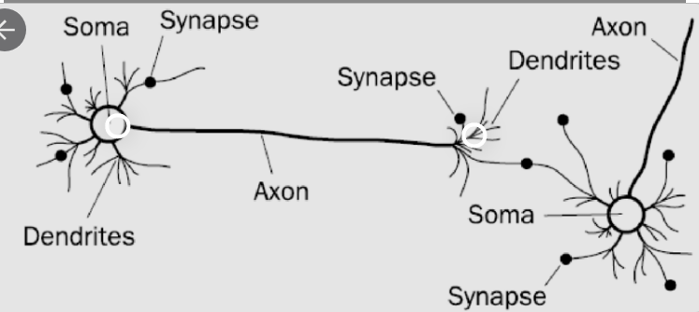
Biological Neuron

Slide 6
NEURAL NETWORK REPRESENTATIONS
An example of ANN learning is provided by system ALVINN, which uses a learned ANN to steer an autonomous vehicle driving at normal speeds on public highways.
The input to the neural network is a 30 x 32 grid of pixel intensities obtained from a forward-pointed camera mounted on the vehicle.
The network output is the direction in which the vehicle is steered.
ALVINN has used its learned networks to successfully drive at speeds up to 70 miles per hour and for distances of 90 miles on public highways

Slide 7
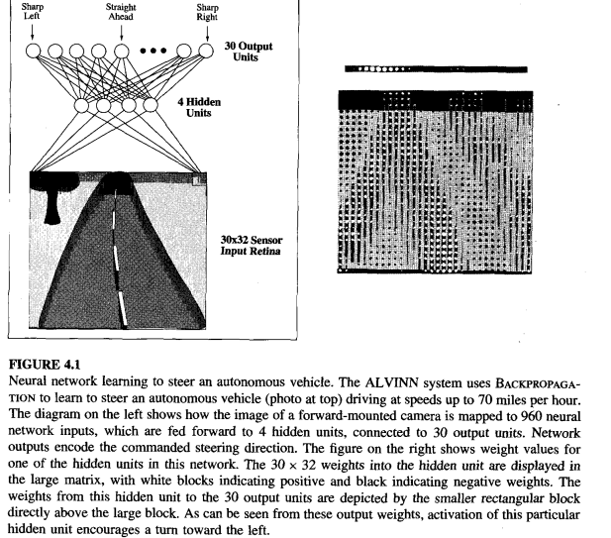

Slide 8
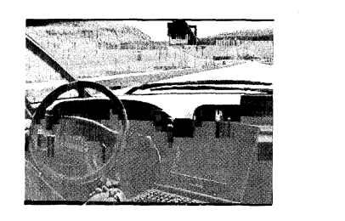
The network is shown on the left side of the figure, with the input camera image depicted below it. Each node (i.e., circle) in the network diagram corresponds to the output of a single network unit, and the lines entering the node from below are its inputs.
there are four units that receive inputs directly from all of the 30 x 32 pixels in the image. These are called "hidden" units because their output is available only within the network and is not available as part of the global network output. Each of these four hidden units computes a single real-valued output based on a weighted combination of its 960 inputs.
These hidden unit outputs are then used
as inputs to a second layer of 30 "output“
units. Each output unit corresponds to a
particular steering direction, and the output
values of these units determine which steering
direction is recommended most strongly.

Slide 9
The diagrams on the right side of the figure depict the learned weight values associated with one of the four hidden units in this ANN.
The large matrix of black and white boxes on the lower right depicts the weights from the 30 x 32 pixel inputs into the hidden unit.
Here, a white box indicates a positive weight, a black box a negative weight, and the size of the box indicates the weight magnitude.
The smaller rectangular diagram directly above the large matrix shows the weights from this hidden unit to each of the 30 output units.

Slide 10
APPROPRIATE PROBLEMS FOR NEURAL NETWORK LEARNING
It is appropriate for problems with the following characteristics:
Instances are represented by many attribute-value pairs:-The target function to be learned is defined over instances that can be described by a vector of predefined features, such as the pixel values in the ALVINN example.
The target function output may be discrete-valued, real-valued, or a vector of several real- or discrete-valued attributes:- For example, in the ALVINN system the output is a vector of 30 attributes, each corresponding to a recommendation regarding the steering direction

Slide 11
The training examples may contain errors:- ANN learning methods are quite robust to noise in the training data.
Long training times are acceptable:- Network training algorithms typically require longer training times than, decision tree learning algorithms. Training times can range from a few seconds to many hours,
Fast evaluation of the learned target function may be required:- ANN learning times are relatively long, evaluating the learned network, in order to apply it to a subsequent instance, is typically very fast.
The ability of humans to understand the learned target function is not important:-The weights learned by neural networks are often difficult for humans to interpret.

Slide 12
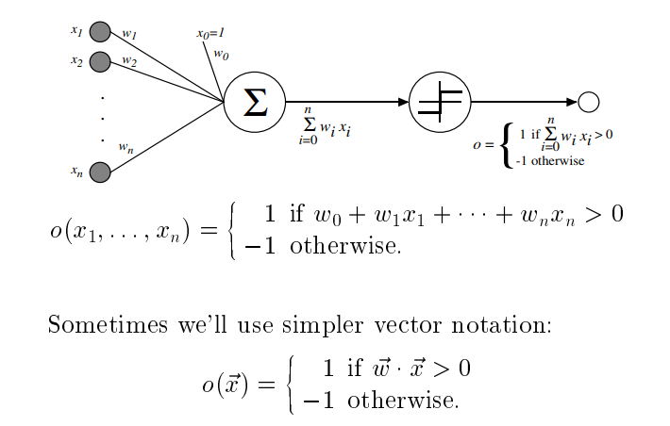
PERCEPTRONS
ANN system is based on a unit called a perceptron.
A perceptron takes a vector of real-valued inputs, calculates a linear combination of these inputs, then outputs a 1 if the result is greater than some threshold and -1 otherwise.
Given inputs x1 through xn, the output o(x1, . . . , xn) computed by the perceptron

Slide 13
where each w_{i} is a real-valued weight, that determines the contribution of input x_{i} to the perceptron output.
Notice the quantity (-w_{O}) is a threshold that the weighted combination of inputs w_{l}x_{l} + . . . + w_{n}x_{n} must surpass in order for the perceptron to output a 1.

Slide 14
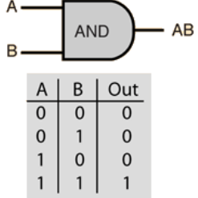
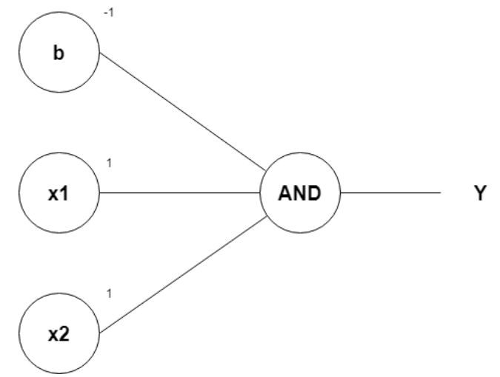
AND operation
Row 1
From w1*x1 + w2*x2 + b, initializing w1, w2, as 1 and b as –1, we get;
x1(1)+x2(1)–1
Passing the first row of the AND logic table (x1=0, x2=0), we get;
0+0–1 = –1
From the Perceptron rule, if Wx+b ≤ 0, then y`=0. Therefore, this row is correct, and no need for Backpropagation.
Row 2
Passing (x1=0 and x2=1), we get;
0+1–1 = 0
From the Perceptron rule, if Wx+b≤0, then y`=0. This row is correct, as the output is 0 for the AND gate.
From the Perceptron rule, this works (for both row 1, row 2 and 3).
Row 4
Passing (x1=1 and x2=1), we get;
1+1–1 = 1
Again, from the perceptron rule, this is still valid.

Slide 15
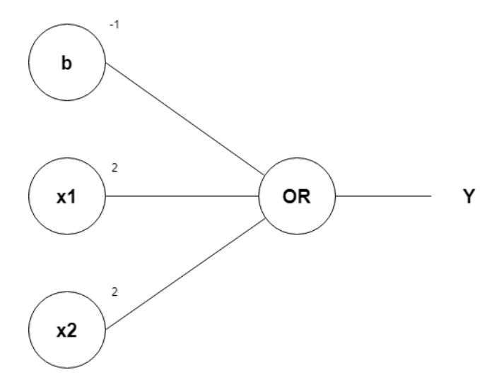
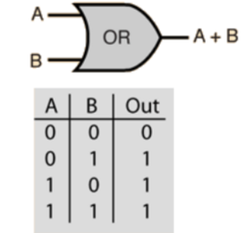
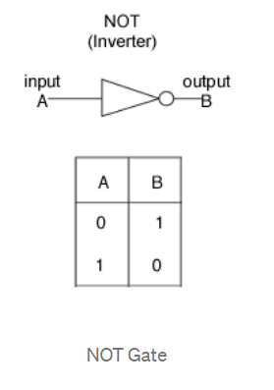
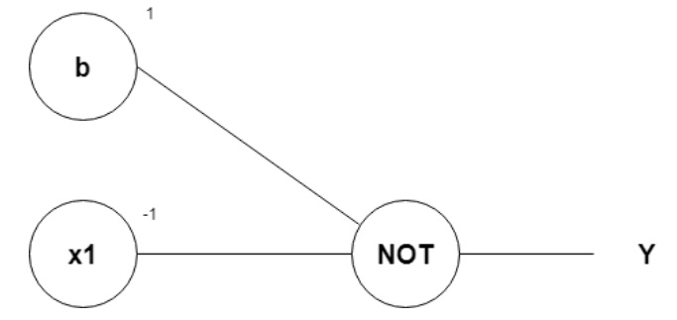
OR operation
NOT operation

Slide 16
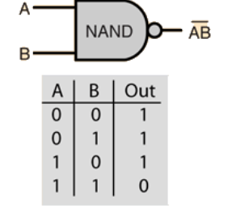
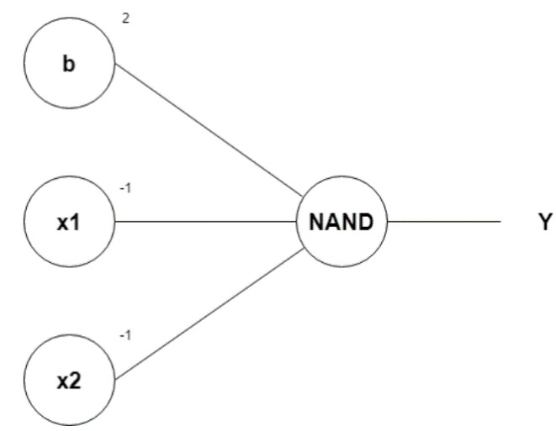
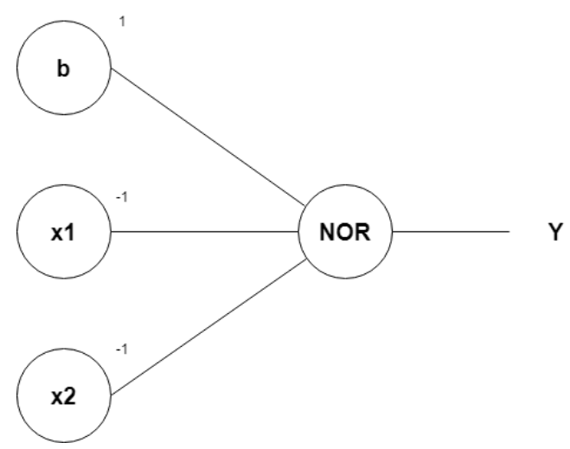
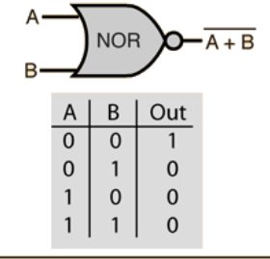

Slide 17
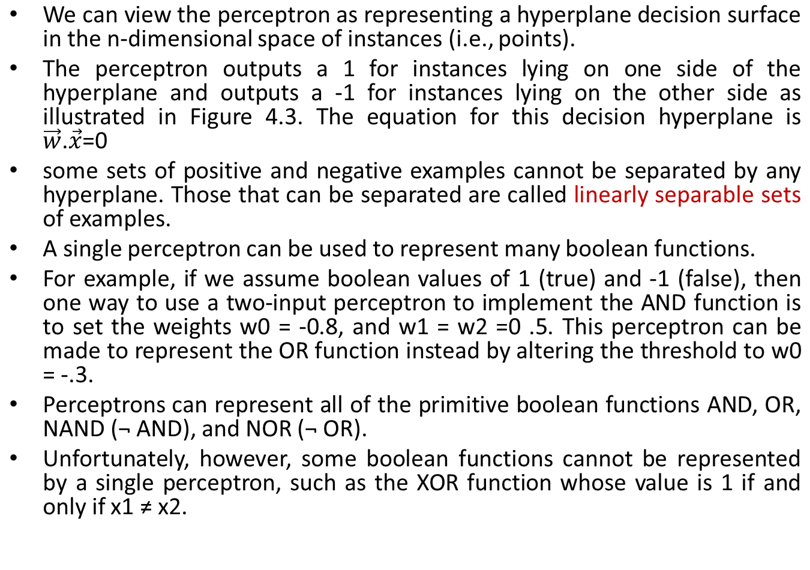
Representational Power of Perceptrons

Slide 18
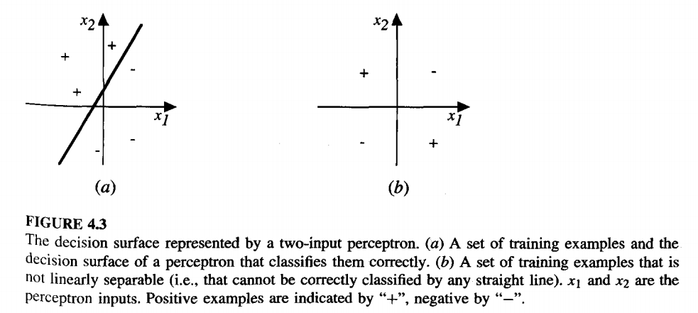
Decision Surface of a Perceptron

Slide 19
Every boolean function can be represented by some network of perceptrons only two levels deep, in which the inputs are fed to multiple units, and the outputs of these units are then input to a second, final stage.
networks of threshold units can represent a rich variety of functions and because single units alone cannot, we will generally be interested in learning multilayer networks of threshold units.

Slide 20
The Perceptron Training Rule
Several algorithms are known to solve this learning problem. Here we consider two algorithms: the perceptron rule and the delta rule (a variant of the LMS rule for learning evaluation functions).
These two algorithms are guaranteed to converge to somewhat different acceptable hypotheses, under somewhat different conditions.
One way to learn an acceptable weight vector is to begin with random weights, then iteratively apply the perceptron rule to each training example, modifying the perceptron weights whenever it misclassifies an example.
This process is repeated, iterating through the training examples as many times as needed until the perceptron classifies all training examples correctly.

Slide 21
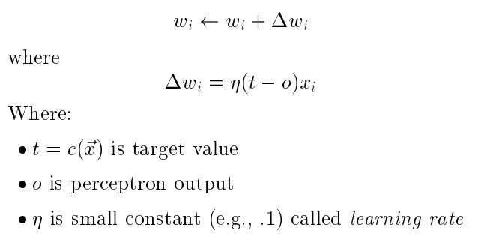
Weights are modified at each step according to the perceptron training rule, which revises the weight wi associated with input xi according to the rule
The role of the learning rate is to moderate the degree to which weights are changed at each step.
It is usually set to some small value (e.g., 0.1) and is sometimes made to decay as the number of weight-tuning iterations increases.

Slide 22
Example
For example, if xi = .8, n = 0.1, t = 1, and o = - 1, then the weight update will be ∆wi = n(t - o)xi = O.1(1 - (-1))0.8 = 0.16.
In fact, the above learning procedure can be proven to converge within a finite number of applications of the perceptron training rule to a weight vector that correctly classifies all training examples, provided the training examples are linearly separable and provided a sufficiently small n is used.
If the data are not linearly separable, convergence is not assured.

Slide 23
Gradient Descent and the Delta Rule
The perceptron rule finds a successful weight vector when the training examples are linearly separable, it can fail to converge if the examples are not linearly separable.
A second training rule, called the delta rule, is designed to overcome this difficulty. If the training examples are not linearly separable, the delta rule converges toward a best-fit approximation to the target concept.
The key idea behind the delta rule is to use gradient descent to search the hypothesis space of possible weight vectors to find the weights that best fit the training examples.

Slide 24
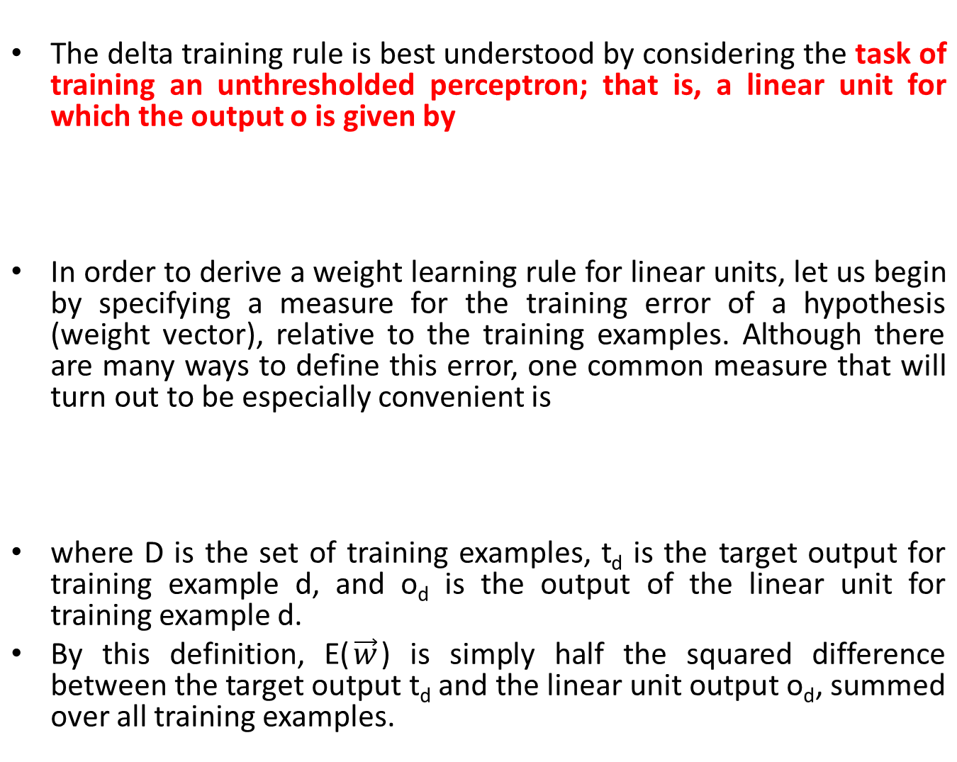


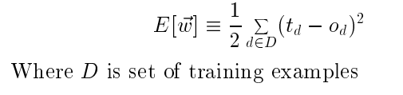

Slide 25
VISUALIZING THE HYPOTHESIS SPACE
To understand the gradient descent algorithm, it is helpful to visualize the entire hypothesis space of possible weight vectors and their associated E values, as illustrated in Figure 4.4.
Here the axes w0 and w1 represent possible values for the two weights of a simple linear unit.
The w0, w1 plane therefore represents the entire hypothesis space.
The vertical axis indicates the error E relative to some fixed set of training examples.
The error surface shown in the figure thus summarizes the desirability of every weight vector in the hypothesis space. we desire a hypothesis with minimum error.
Given the way in which we chose to define E, for linear units this error surface must always be parabolic with a single global minimum.
The specific parabola will depend, of course, on the particular set of training examples.

Slide 26
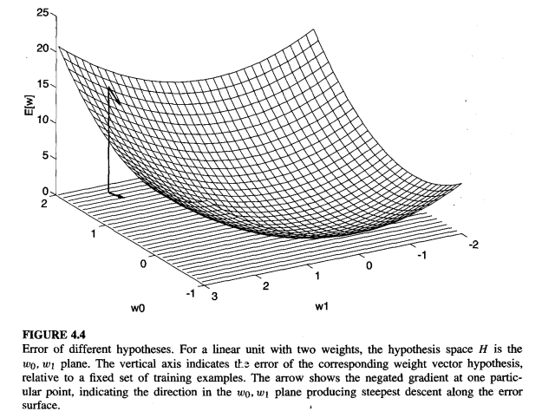
VISUALIZING THE HYPOTHESIS SPACE

Slide 27
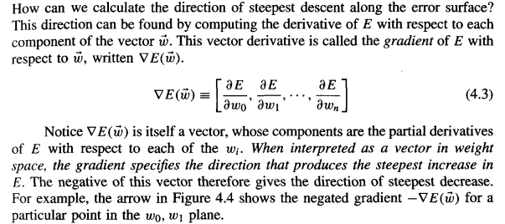
DERIVATION OF THE GRADIENT DESCENT RULE

Slide 28
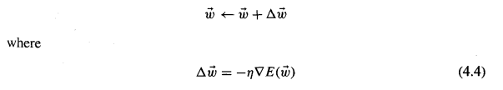
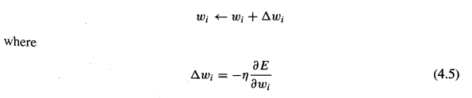
Since the gradient specifies the direction of steepest increase of E, the training rule for gradient descent is
Here n is a positive constant called the learning rate, which determines the step size in the gradient descent search.
The negative sign is present because we want to move the weight vector in the direction that decreases E.
This training rule can also be written in its component form

Slide 29
To construct a practical algorithm for iteratively updating weights according to Equation (4.5), we need an efficient way of calculating the gradient at each step.
The vector of derivatives that form the gradient can be obtained by differentiating E from Equation (4.2)
----4.2

Slide 30
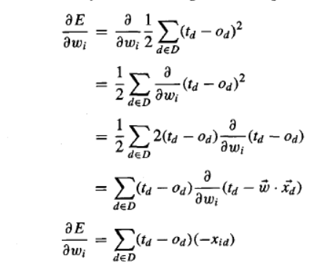
-----4.6

Slide 31


where denotes the single input component xi for training example d.
We now have an equation that gives in terms of the linear unit inputs , outputs , and target values td associated with the training examples.
Substituting Equation (4.6) into Equation (4.5) yields the weight update rule for gradient descent
------ 4.7

Slide 32
To summarize, the gradient descent algorithm for training linear units is as follows: Pick an initial random weight vector.
Apply the linear unit to all training examples, then
compute for each weight according to Equation (4.7).
Update each weight W_{i} by adding , then repeat this process.
This algorithm is given in Table 4.1. Because the error surface contains only a single global minimum, this algorithm will converge to a weight vector with minimum error, given a sufficiently small learning rate n is used.
If n is too large, the gradient descent search runs the risk of overstepping the minimum in the error surface rather than settling into it.
For this reason, one common modification to the algorithm is to gradually reduce the value of n as the number of gradient descent steps grows.

Slide 33
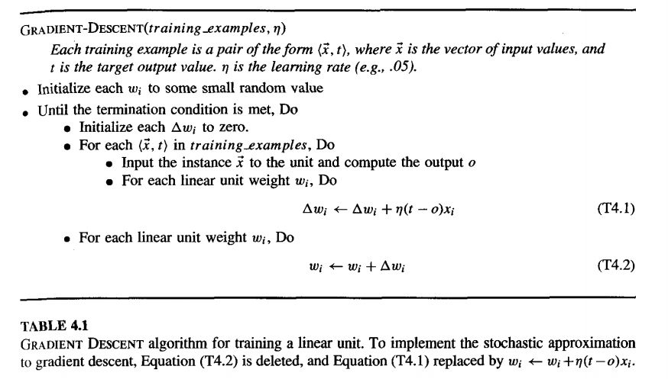

Slide 34
STOCHASTIC APPROXIMATION TO GRADIENT DESCENT
Gradient descent is an important general paradigm for learning.
It is a strategy for searching through a large or infinite hypothesis space that can be applied whenever
(1) the hypothesis space contains continuously parameterized hypotheses (e.g., the weights in a linear unit), and
(2) the error can be differentiated with respect to these hypothesis parameters.
The key practical difficulties in applying gradient descent are
(1) converging to a local minimum can sometimes be quite slow (i.e., it can require many thousands of gradient descent steps), and
(2) if there are multiple local minima in the error surface, then there is no guarantee that the procedure will find the global minimum.

Slide 35
One common variation on gradient descent intended to alleviate these difficulties is called incremental gradient descent, or alternatively stochastic gradient descent.
Whereas the gradient descent training rule presented in Equation (4.7) computes weight updates after summing over all the training examples in D, the idea behind stochastic gradient descent is to approximate this gradient descent search by updating weights incrementally, following the calculation of the error for each individual example.
The modified training rule is like the training rule given by Equation (4.7) except that as we iterate through each training example we update the weight according to
where t, o, and xi are the target value, unit output, and ith input for the training example in question. To modify the gradient descent algorithm of Table 4.1 to implement this stochastic approximation, Equation (T4.2) is simply deleted and Equation (T4.1) replaced by
The training rule In equation 4.10 is known as Delta Rule

Slide 36
Multi Layer Networks and The Backpropagatio Algorithm
Single perceptrons can only express linear decision surfaces. In contrast, multilayer networks learned by the BACKPROPACATION algorithm are capable of expressing a variety of nonlinear decision surfaces.
For example, a typical multilayer network and decision surface is depicted in Figure 4.5.
Here the speech recognition task involves distinguishing among 10 possible vowels, all spoken in the context of "h-d" (i.e., "hid," "had," "head," "hood," etc.).
The input speech signal is represented by two numerical parameters obtained from a spectral analysis of the sound, allowing us to easily visualize the decision surface over the two-dimensional instance space.
As shown in the figure, it is possible for the multilayer network to represent highly nonlinear decision surfaces that are much more expressive than the linear decision surfaces of single units shown earlier in Figure 4.3.

Slide 37
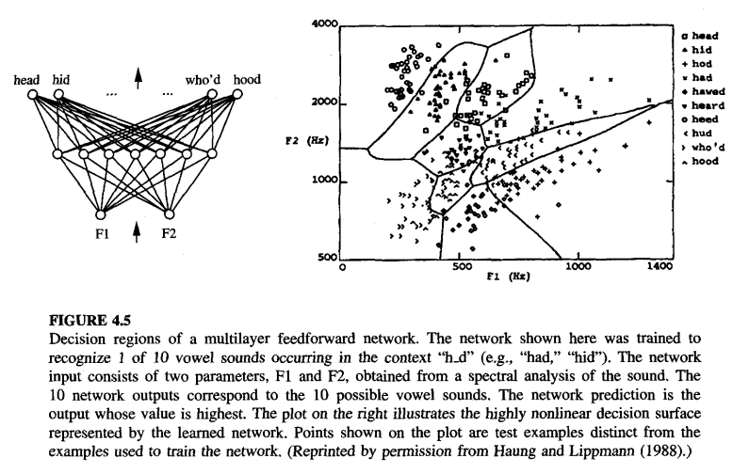

Slide 38
A Differentiable Threshold Unit
What type of unit shall we use as the basis for constructing multilayer networks?
The perceptron unit is a possible choice, but its discontinuous threshold makes it un differentiable and hence unsuitable for gradient descent
What we need is a unit whose output is a nonlinear function of its inputs, but whose output is also a differentiable function of its inputs. One solution is the sigmoid unit-a unit very much like a perceptron, but based on a smoothed, differentiable threshold function.

Slide 39
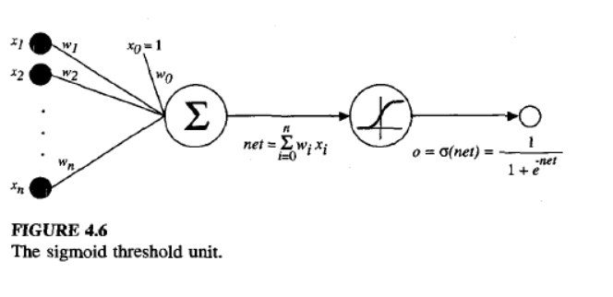
The sigmoid unit is illustrated in Figure 4.6. Like the perceptron, the sigmoid unit first computes a linear combination of its inputs, then applies a threshold to the result.
In the case of the sigmoid unit, however, the threshold output is a continuous function of its input.

Slide 40
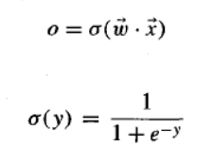

More precisely, the sigmoid unit computes its output o as
Where σ is often called the sigmoid function or, alternatively, the logistic function.
its output ranges between 0 and 1, increasing monotonically with its input
Because it maps a very large input domain to a small range of outputs, it is often referred to as the squashing function of the unit.
The sigmoid function has the useful property that its derivative is easily expressed in terms of its output
------ 4.12

Slide 41
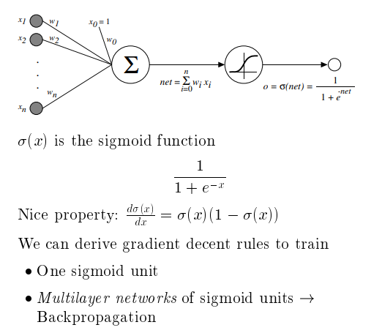

Slide 42
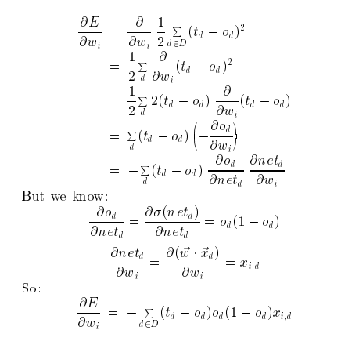
Error Gradient for a Sigmoid Unit

Slide 43

BACKPROPAGATION Algorithm
The BACKPROPAGATION algorithm learns the weights for a multilayer network, given a network with a fixed set of units and interconnections. It employs gradient descent to minimize the squared error between the network output values and the target values for these outputs.
Because we are considering networks with multiple output units rather than single units as before, we redefine E to sum the errors over all of the network output units.
where outputs is the set of output units in the network, and t_{kd} and O_{kd} are the target and output values associated with the kth output unit and training example d.

Slide 44
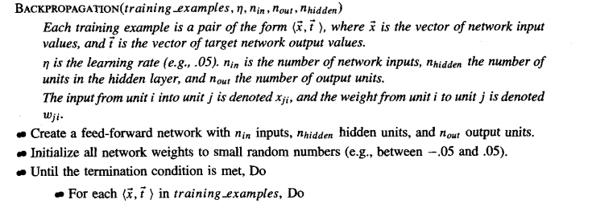
BACKPROPAGATION Algorithm

Slide 45
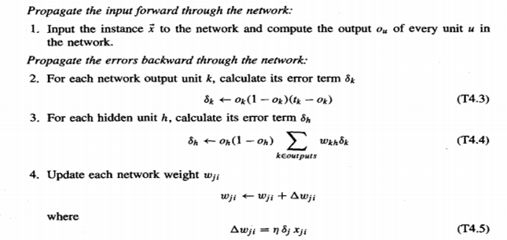


Slide 46
One major difference in the case of multilayer networks is that the error surface can have multiple local minima, in contrast to the single-minimum parabolic error surface.
Unfortunately, this means that gradient descent is guaranteed only to converge toward some local minimum, and not necessarily the global minimum error.
Despite this obstacle, in practice BACKPROPAGATION has been found to produce excellent results in many real-world applications
The algorithm applies to layered feed forward networks containing two layers of sigmoid units, with units at each layer connected to all units from the preceding layer.

Slide 47
This is the incremental, or stochastic, gradient descent version of BACKPROPAGATION.
The notation used here is the same as that used in earlier sections, with the following extensions:
  xji denotes the input from node i to unit j, and wji denotes the corresponding weight.
  , denotes the error term associated with unit n. It plays a role analogous to the quantity (t - o) in our earlier discussion of the delta training rule.
  As we shall see later

Slide 48
The algorithm begins by constructing a network with the desired number of hidden and output units and initializing all network weights to small random values.
Given this fixed network structure, the main loop of the algorithm then repeatedly iterates over the training examples.
For each training example, it applies the network to the example, calculates the error of the network output for this example, computes the gradient with respect to the error on this example, then updates all weights in the network.
This gradient descent step is iterated (often thousands of times, using the same training examples multiple times) until the network performs acceptably well.
The gradient descent weight-update rule is similar to the delta training rule. Like the delta rule, it updates each weight in proportion to the learning rate η, the input value xji to which the weight is applied, and the error in the output of the unit.
The only difference is that the error (t - o) in the delta rule is replaced by a more complex error term, The exact form of follows from the derivation of the weight tuning rule.
To understand it intuitively, first consider how is computed for each network output unit k.
is simply the familiar (tk - ok) from the delta rule, multiplied by the factor
which is the derivative of the sigmoid squashing function.
The value for each hidden unit h . However, since training examples provide target values tk only for network outputs, no target values are directly available to indicate the error of hidden units' values.
Instead, the error term for hidden unit h is calculated by summing the error terms for each output unit influenced by h, weighting each of the by Wkh, the weight from hidden unit h to output unit k. This weight characterizes the degree to which hidden unit h is "responsible for" the error in output unit k.

Slide 49
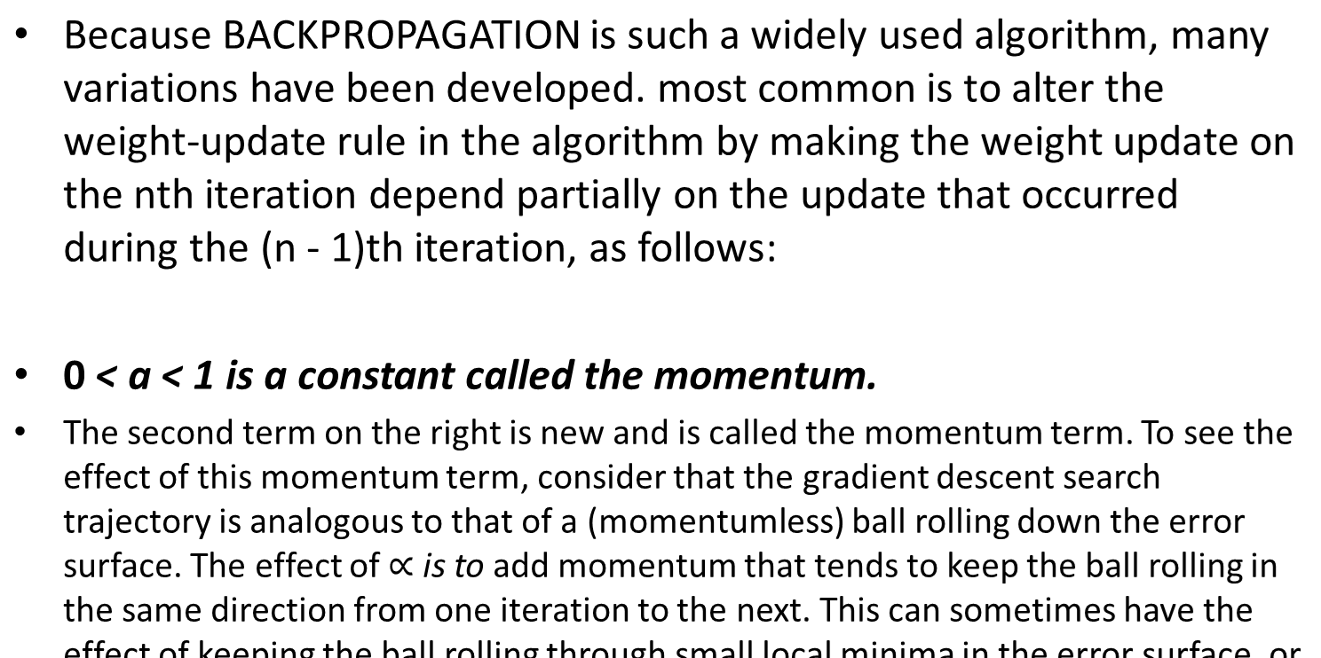
ADDING MOMENTUM

Slide 50


LEARNING IN ARBITRARY ACYCLIC NETWORKS
The algorithm given there easily generalizes to feedforward networks of arbitrary depth.
Only change is to the procedure for computing δ values. In general, the δ_{r} value for a unit r in layer m is computed from the δ values at the next deeper layer m + 1 according to
It is equally straightforward to generalize the algorithm to any directed
acyclic graph, regardless of whether the network units are arranged in uniform
layers as we have assumed up to now. In the case that they are not, the rule for
calculating δ for any internal unit (i.e., any unit that is not an output) is
where Downstream(r) is the set of units immediately downstream from unit r in
the network: that is, all units whose inputs include the output of unit r.

Slide 51
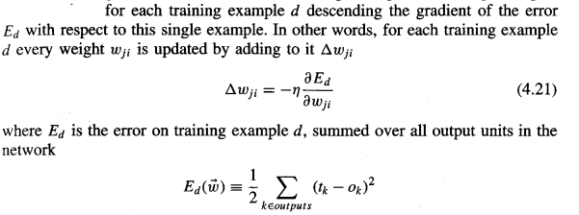
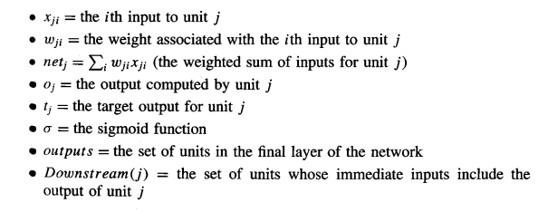
Derivation of the BACKPROPAGATION Rule

Slide 52

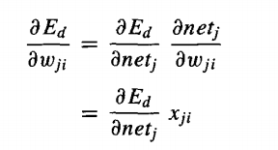

We now derive an expression for in order to implement the stochastic gradient descent rule .
To begin, notice that weight wji can influence the rest of the network only through netj. Therefore, we can use the chain rule to write
…. 4.22
Given Equation (4.22), our remaining task is to derive a convenient expression for
We consider two cases in turn: the case where unit j is an output unit for the network, and the case where j is an internal unit.

Slide 53
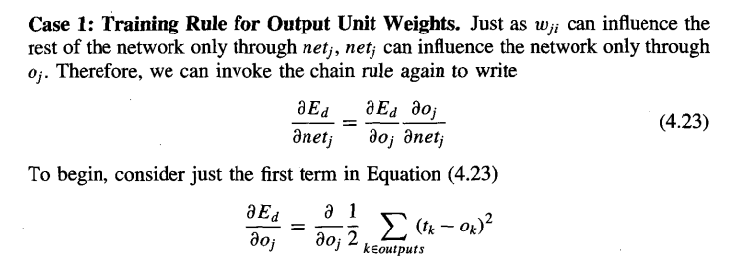

Slide 54
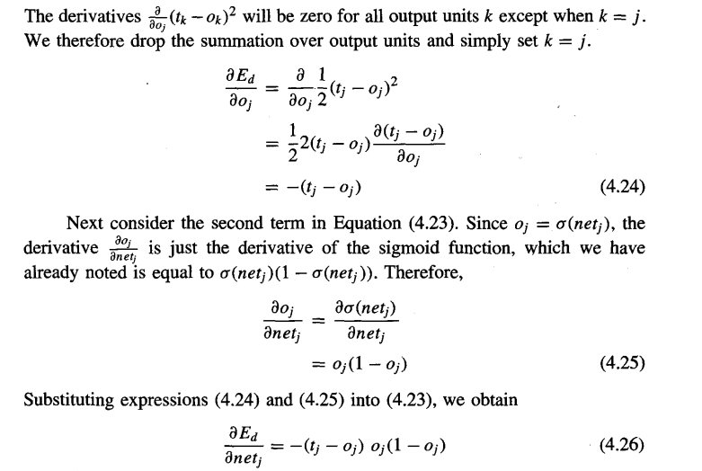

Slide 55

and combining this with Equations (4.21) and (4.22), we have the stochastic gradient descent rule for output units.
Case 2: Training Rule for Hidden Unit Weights. In the case where j is an internal, or hidden unit in the network, the derivation of the training rule for wji must take into account the indirect ways in which wji can influence the network outputs and hence E_{d}.
We denote this set of units by Downstream(j). netj can influence the network outputs (and therefore E_{d}) only through the units in Downstream(j). Therefore, we can write

Slide 56
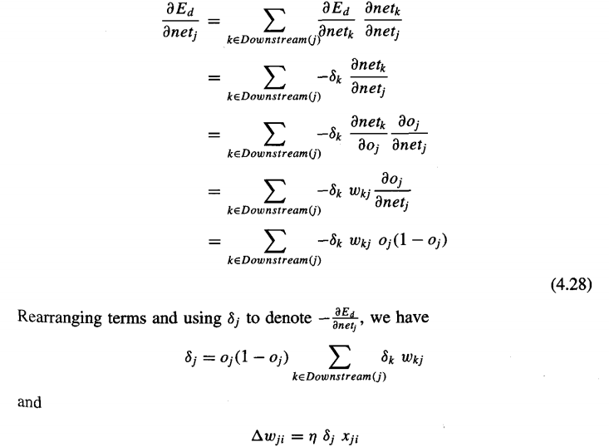

Slide 57
Convergence
The BACKPROPAGATION algorithm implements a gradient descent search through the space of possible network weights, iteratively reducing the error E between the training example target values and the network outputs.
Because the error surface for multilayer networks may contain many different local minima, gradient descent can become trapped in any of these. As a result, BACKPROPAGATION over multilayer networks is only guaranteed to converge toward some local minimum in E and not necessarily to the global minimum error.
Consider that networks with large numbers of weights correspond to error surfaces in very high dimensional spaces (one dimension per weight).
When gradient descent falls into a local minimum with respect to one of these weights, it will not necessarily be in a local minimum with respect to the other weights.
In fact, the more weights in the network, the more dimensions that might provide "escape routes" for gradient descent to fall away from the local minimum with respect to this single weight.

Slide 58
A second perspective on local minima can be gained by considering the manner in which network weights evolve as the number of training iterations increases.
if network weights are initialized to values near zero, then during early gradient descent steps the network will represent a very smooth function that is approximately linear in its inputs.
This is because the sigmoid threshold function itself is approximately linear when the weights are close to zero
Only after the weights have had time to grow will they reach a point where they can represent highly nonlinear network functions.

Slide 59
Common heuristics to attempt to alleviate the problem of local minima include:
  Add a momentum term to the weight-update rule. Momentum can sometimes carry the gradient descent procedure through narrow local minima
  Use stochastic gradient descent rather than true gradient descent. It descends a different error surface for each training example, relying on the average of these to approximate the gradient with respect to the full training set. These different error surfaces typically will have different local minima, making it less likely that the process will get stuck in any one of them.
  Train multiple networks using the same data, but initializing each network with different random weights. If the different training efforts lead to different local minima, then the network with the best performance over a separate validation data set can be selected.

Slide 60
Generalization
What is an appropriate condition for terminating the weight update loop?
- One choice is to continue training until the error E on the training examples falls below some predetermined threshold.
- this is a poor strategy because BACKPROPAGATION is susceptible to over-fitting the training examples at the cost of decreasing generalization accuracy over other unseen examples.
To see the dangers of minimizing the error over the training data, consider how the error E varies with the number of weight iterations. Figure 4.9 shows this variation for two fairly typical applications of BACKPROPAGATION. Consider first the top plot in this figure.
The lower of the two lines shows the monotonically decreasing error E over the training set, as the number of gradient descent iterations grows. The upper line shows the error E measured over a different validation set of examples, distinct from the training examples.
This line measures the generalization accuracy of the network-the accuracy with which it fits examples beyond the training data.

Slide 61
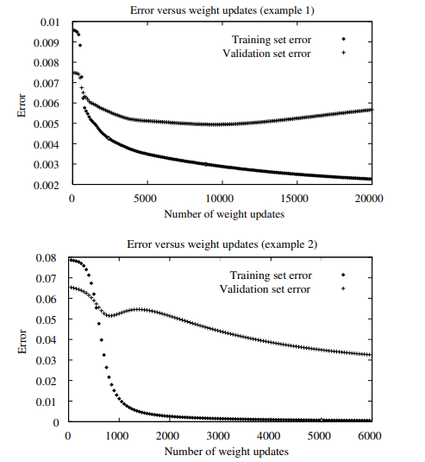
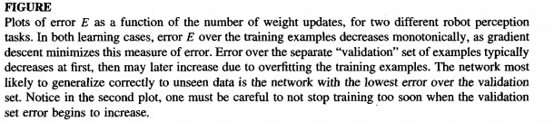

Slide 62
generalization accuracy measured over the validation examples first decreases, then increases, even as the error over the training examples continues to decrease.
This occurs because the weights are being tuned to fit the training examples that are not representative of the general distribution of examples.
overfitting tend to occur during later iterations, but not during earlier iterations

Slide 63
Several techniques are available to address the overfitting problem for BACKPROPAGATION learning.
One approach, known as weight decay, is to decrease each weight by some small factor during each iteration.
This is equivalent to modifying the definition of E to include a penalty term corresponding to the total magnitude of the network weights.
The motivation for this approach is to keep weight values small, to bias learning against complex decision surfaces.

Slide 64
however, the problem of overfitting is most severe for small training sets.
In these cases, a k-fold cross-validation approach is sometimes used, in which cross validation is performed k different times,
In one version of this approach, the m available examples are partitioned into k disjoint subsets, each of size m/k. The cross validation procedure is then run k times,
each time using a different one of these subsets as the validation set and combining the other subsets for the training set. Thus, each example is used in the validation set for one of the experiments and in the training set for the other k - 1 experiments.
On each experiment the cross-validation approach is used to determine the number of iterations i that yield the best performance on the validation set.
The mean i of these estimates is then calculated, and a final run of BACKPROPAGATIO is performed training on all n examples for i iterations, with no validation set.

Slide 65
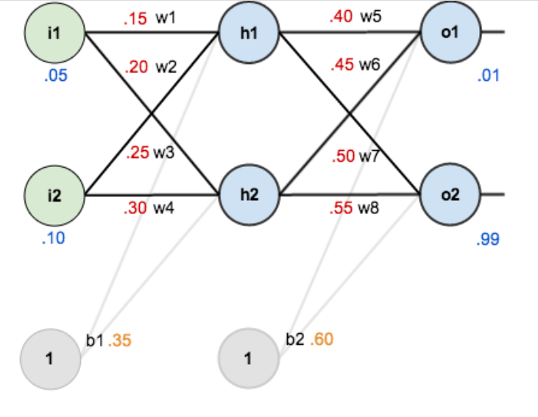

Slide 66
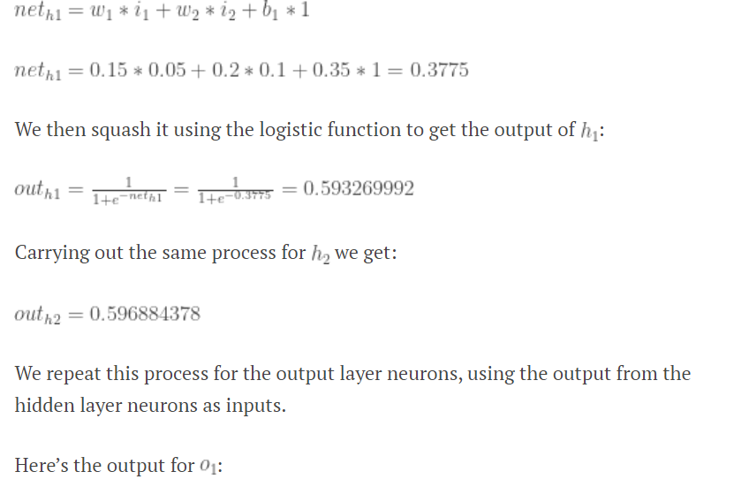

Slide 67
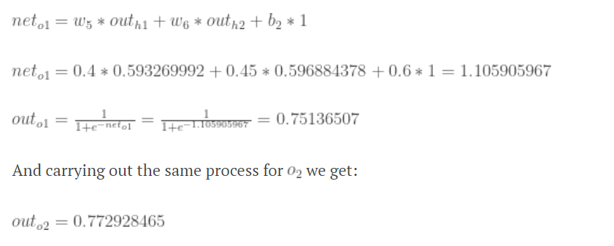

Slide 68

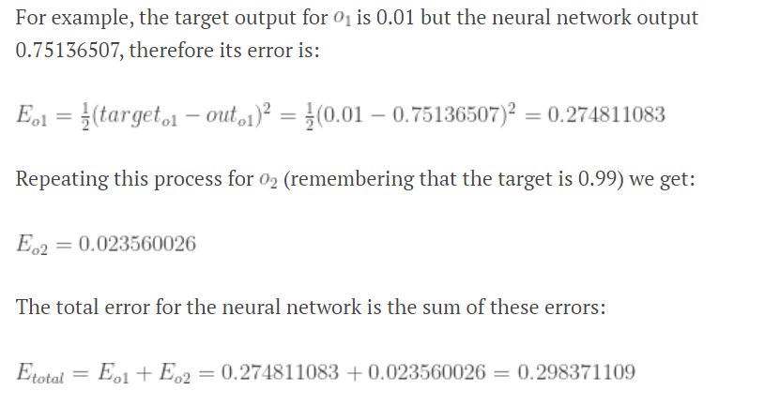
Calculating the Total Error

